Slide 1
Scleroderma
Dr. Husham Aldaoseri
6.Nov.2023

Slide 2
Learning Objectives
Describe the epidemiology and pathophysiology of systemic sclerosis (SSc)
Understand the typical disease presentation and clinical findings of SSc
Contrast limited cutaneous disease (lcSSc) and diffuse cutaneous disease (dcSSc)
Describe the prognosis and possible complications of SSc
Outline the approach to treating and monitoring patients with SSc

Slide 3
QUES/A39-year-old woman complains of developing painful pale fingers on cold exposure for the past 5 years. Recently, she has noticed swollen fingers and tight skin, which limit flexion and extension. She also has new abdominal symptoms that are bothersome. On examination, the skin on the fingers is smooth and shiny with associated edema. The rest of the examination is normal.
A. What is the most likely diagnosis ?
B. What is the most specific autoantibodies test for diagnosis ?
C. What is the most appropriate step in management?

Slide 4
Systemic sclerosis is a chronic multisystem disorder of unknown etiology characterized by the overproduction and accumulation of collagen with thickening of the skin and by structural and functional abnormalities of visceral organs, including the GI tract, lung, heart and kidneys
 Epidemiology
 Usual onset in 30s or 40s
 Female-to-male ratio is between 3-5:1
 More common in African Americans than whites

Slide 5
Terminology
Scleroderma
Localized Scleroderma
Systemic Sclerosis (SSc)
Morphea
Linear Scleroderma
Scleroderma en coup de sabre
Diffuse cutaneous SSc
Limited cutaneous SSc
Notes:
I would like to start by clarifying some terminology. Scleroderma is an umbrella term that refers to a number of different diseases. There are localized forms of scleroderma which are conditions primarily of children and typically only involve the skin. Morphea, linear scleroderma, and scleroderma en coup de sabre are 3 such forms of localized scleroderma. There is a separate module covering localized scleroderma. This lecture will concentrate on another form of scleroderma, called systemic sclerosis. As the name implies, this form of scleroderma has systemic manifestations which are critical to understand. Systemic sclerosis is divided into diffuse cutaneous disease and limited cutaneous disease. I will highlight the differences in these conditions as we move through the module.

Slide 6
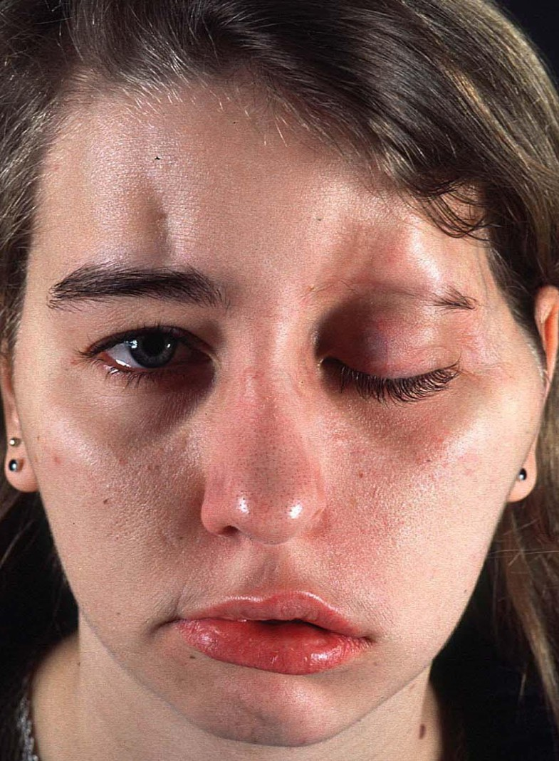
LOCALIZED FORMS
Morphea
Generalized / pansclerotic morphea
Linear scleroderma
En coup de saber

Slide 7
MORPHEA
A rare skin condition that causes reddish or purplish patches on skin.
Tends to affect only the outermost layers of skin — the dermis and the fatty tissue just beneath the dermis.
Location –
Abdomen, chest and back
Face, Arms and legs

Slide 8
Signs of morphea -
Hardening and thickening of the skin.
Discoloration of the affected skin to look lighter or darker than the surrounding area.
Oval-shaped patches that may change colors and gradually develop a whitish center.
Linear patches, especially when on arms and legs
Loss of hair and sweat glands in the affected area over time.

Slide 9
Systemic sclerosis
a multisystem disorder characterized by
functional and structural abnormalities of blood vessels
fibrosis of the skin and internal organs
immune system activation
autoimmunity

Slide 10
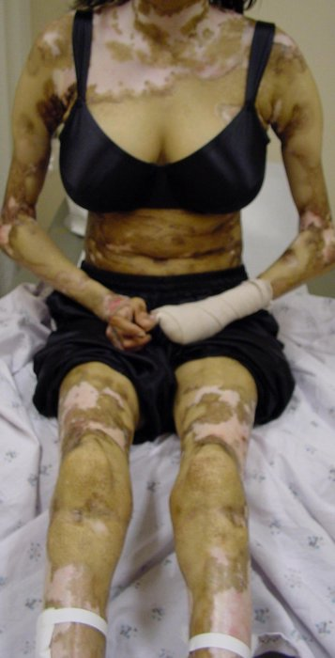
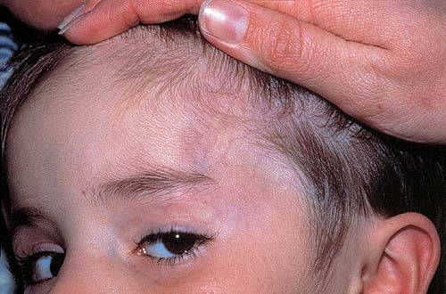
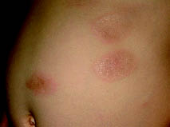

Slide 11
Classification of systemic sclerosis
Diffuse cutaneous systemic sclerosis
Proximal skin thickening involving the trunk , upper arms and thighs, in addition to symmetrical involvement of the finger, hands , arms and face / neck
Tendency to rapid progression of skin change
Rapid onset of disease following Raynaud’s phenomenon
Early appearance of visceral involvement
Poor prognosis with survival 40% to 60% at 10year

Slide 12
Limited cutaneous systemic sclerosis
symmetric restricted fibrosis affecting the distal extremities and face
prolonged delay in appearance of distinctive internal manifestation
prominence of calcinosis and telangiectasia
good prognosis with survival > 70% at 10 year
* CREST syndrome

Slide 13
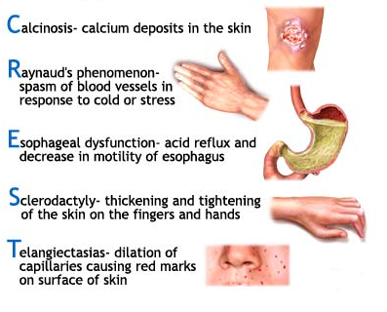
CREST syndrome

Slide 14
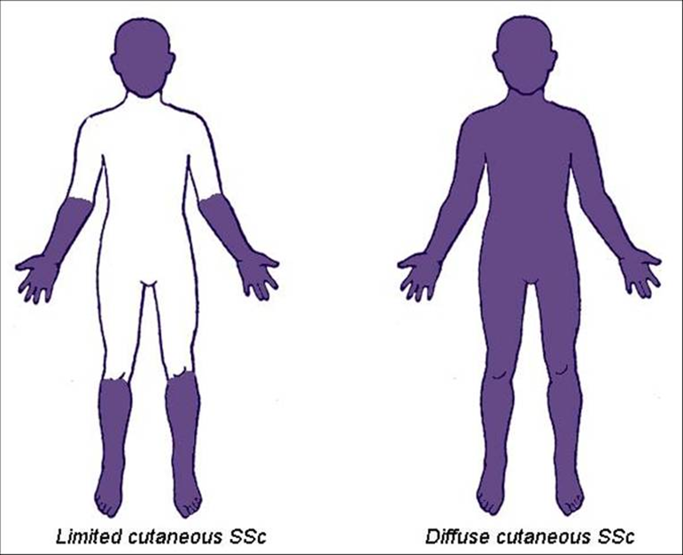

Slide 15
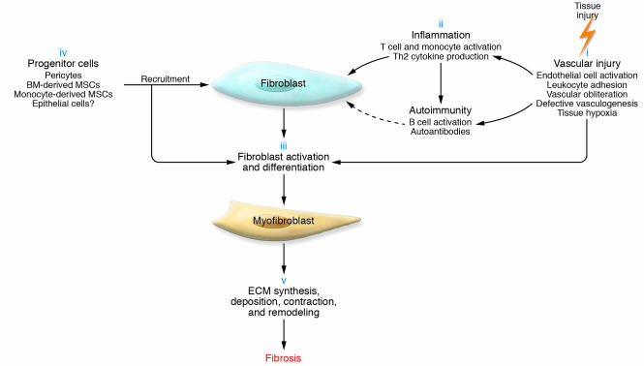
Pathogenesis of Scleroderma
Notes:
Pathogenesis of systemic sclerosis vasculopathy. Endothelial injury and dysfunction are initiated by the actions of free radicals or chemical and microbial agents that injure the endothelium, either directly or indirectly. This injury is also initiated by the induction of immune activation and the generation of autoantibodies and activated cellular immunity. The vascular injury activates platelet and coagulation pathways, which results in vascular microthrombosis. The resulting vasculopathy is associated with intimal hyperplasia in the small arterioles, and the ensuing luminal narrowing results in tissue hypoxia and chronic ischemia. Released vascular products, in association with hypoxia and ischemia, collectively contribute to the activation of resident fibroblasts, which in turn perpetuates the vasculopathy by triggering vascular wall fibrosis.
© This slide is made available for non-commercial use only. Please note that permission may be required for re-use of images in which the copyright is owned by a third party.

Slide 16
Disease Presentation
Pre-clinical
Patient asymptomatic
+ Autoantibodies
Very
Early
Established Raynaud’s
Early Advanced
Progressive skin fibrosis and variable organ involvement
Diffuse itching
May have Raynaud’s
Joint pain
Diffusely puffy fingers
Notes:
Systemic sclerosis is a chronic, progressive disease that looks different in early vs late stages. In the pre-clinical stage, a patient may have no symptoms at all or perhaps they have started to experience isolated Raynaud’s phenomenon. Autoantibodies would be present. A little later in the disease course, a patient may have diffusely puffy fingers and itching. At this point, Raynaud’s may be a prominent symptom. In advanced disease, symptoms such as shortness of breath, trouble swallowing, and marked skin changes may dominate the clinical picture.

Slide 17
MSK
-joint & muscle pain
-tendon friction rubs
-osteolysis
CARDIAC
-Pericarditis
-Pericardial effusion
-Cardiomyopathy
SKIN
-Tightening
-Calciniosis
-Telangiectasias
-Pigment
changes
VASCULAR
-Raynaud’s
Digital ischemic injury
GI
-GERD
-Dysmotility
-Diarrhea
-Malabsorption
LUNG
-Interstitial lung dz
-Pulmonary hypertension
RENAL
-Scleroderma renal crisis
Notes:
The clinical manifestations of systemic sclerosis are quite varied and depend largely on which organ systems are involved in a particular patient. Whether a patient has diffuse cutaneous systemic sclerosis or limited cutaneous systemic sclerosis will also play a role in disease expression.
While I have divided the different disease manifestations by organ system, recognize that all the symptoms and complications have vascular damage and dysfunction as major contributing factors.

Slide 18
Clinical features
Vascular abnormalities
Raynaud's phenomenon
cold hands and feet with reversible skin color change (white to blue to red)
induced by cold temperature or emotional stress
initial complaint in 3/4 of patients
90% in patients with skin change
(prevalence in the general population: 5-10%)
Digital ischemic injury

Slide 19
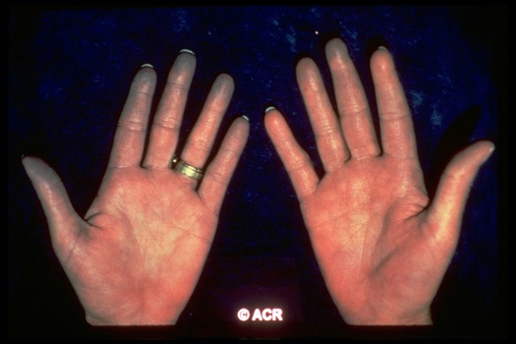
Raynaud’s phenomenon

Slide 20
Terminal digit resorption

Slide 21
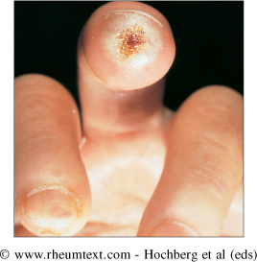
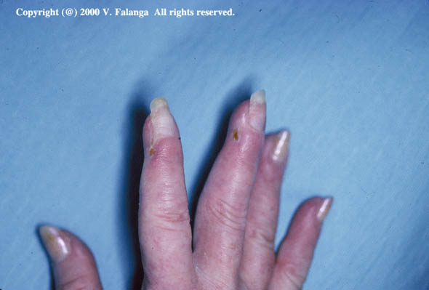
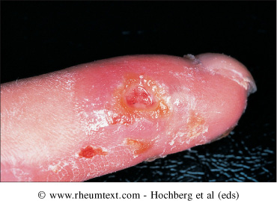
Digital ulcers – evidence of vascular disease

Slide 22
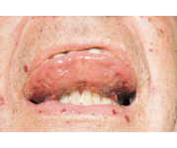
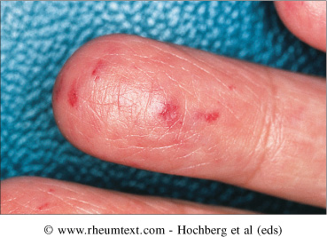
Telangiectasia

Slide 23
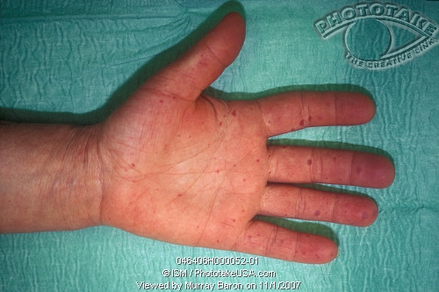
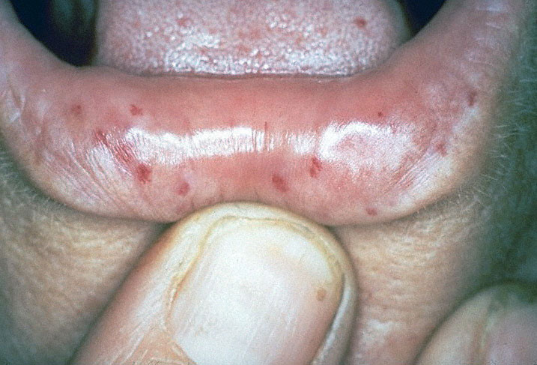

Slide 24
Skin involvement
Stage
❶ edematous phase
❷ indurative phase
❸ atrophic phase
firm, thickened bound to underlying soft tissue
decrease in range of motion, loss of facial expression, inability to open mouth fully

Slide 25
Thick
Shiny
Taught
Tightly adheres to underlying tissue so cannot be easily pickup
Creases disappear
May become hyper- or hypo-pigmented
Hair loss
Decreased sweating

Slide 26
Edematous phase

Slide 27
Skin Induration

Slide 28
Acrosclerosis

Slide 29
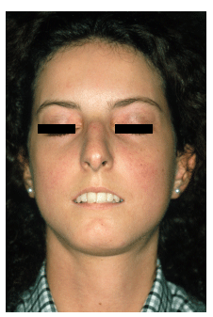
Facial changes
Pinched nose
Cannot elevate eyelids
Lip thinning and retraction

Slide 30
Intestinal involvement
Esophagus: hypomotility and retrosternal pain,
reflux esophagitis, stricture
Stomach: delayed emptying , gastritis , gastric antral vascular ectasia GAVE (watermelon)
Small intestine: pseudo-obstruction, paralytic ileus,
malabsorption
Large intestine: chronic constipation and wide- mouthed diverticuli

Slide 31
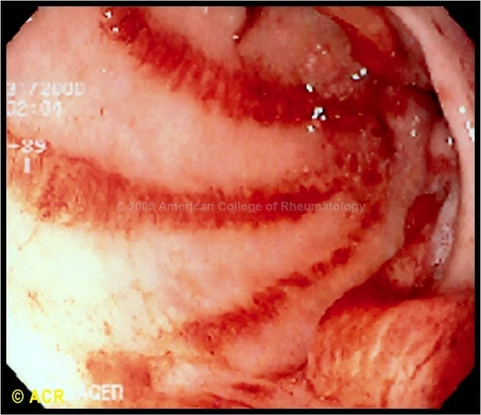
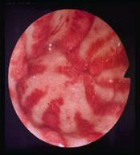
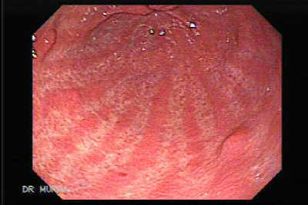

Slide 32
Pulmonary features
Leading cause of death.
ILD,PAH
Less frequently –aspiration pneumonitis , pulmonary hemorrhage , obliterative bronchiolitis , pleural involvement , spontaneous pneumothorax.
↑ broncho alveolar carcinoma
Asymptomatic until advanced.
Most frequent symptoms of pulmonary involvement are subtle .
Velcro crackles at lung base.
PFT for detection -- ILD↓FVC, ↓ DLCO ,,, PAH DLCO ↓↓↓

Slide 33
RENAL Crisis
Presentation –abrupt onset of malignant HTN, severe headache, blurred vision , chest pain.
10% normal BP – normotensive renal crises.
Urinalysis -- proteinuria, microscopic hematuria, fragmented RBCs
Rapidly progressive oliguric renal failure follows
Creatnine > 3 mg/dl at presentation –poor prognosis.—permanent hemodialysis –high mortality,

Slide 34
Cardiac
Myocardial ,pericardial ,conduction abnormalities.
Can occur secondary to renal ,pulmonary involvement.
Asymptomatic until HF ,arryhthmias occurs.
Myocarditis in assosciation with inflammatroy polymyositis.
Conduction defects due to fibrosis of conduction system.
Pericardial effusion –symptoms– rarely tamponade.

Slide 35
Musculoskeletal
CARPAL TUNNEL SYNDROME –may be a presenting feature.
Early disease –generalized arthralgia , stiffness.
Joint mobility affected in diffuse disease.
HANDS –PIP joints, wrists.
Tendon friction rubs are present.—extensive fibrosis, adhesion of tendon sheaths.
True joint inflammation in early of disease.
Muscle weakness due to disuse, malnutrition.
Chronic noninflammatroy myopathy is usually seen.
Bone resorption –a frequent late complication –terminal phalanges –loss of distal tufts –ACRO OSTEOLYSIS.

Slide 36
Acrolysis

Slide 37
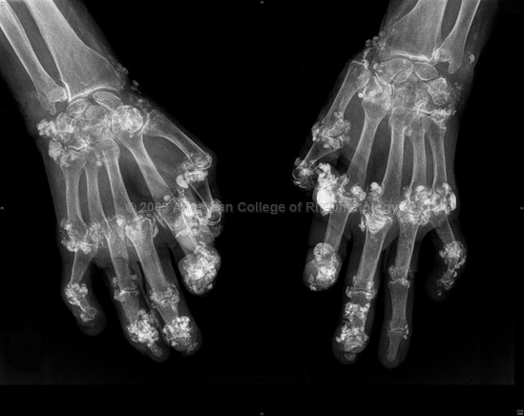
Calcinosis in long standing systemic sclerosis.

Slide 38
Diagnosis
Diagnosis on clinical grounds.
Presence of skin induration with a characteristic symmetrical distribution pattern, typical visceral organ manifestation-establishes the diagnosis with high certainly.
Nail fold capillary microscopy for differentiation from primary Reynaud's

Slide 39
Systemic Sclerosis (Scleroderma)
Investigation
Full blood count
- Normocytic, Normochromic anemia
- Microangiopathic haemolytic anemia in some people
Urea and electrolyte rise in acute kidney injury
- Urine microscopy, proteinuria, creatinine should be measured

Slide 40
Systemic Sclerosis (Scleroderma)
Investigations
Antibodies
Anti centromere anti bodies (ACAs) occur in 50% of cases in LcSSc
Anti topoisomerase-1 (called Anti-ScL-70) in 30% of cases in DcSSc
Anti RNA Polymerase is associated with SRC
ANA is positive in 95%
Rheumatoid factor is positive in 30%

Slide 42
Treatment
Vascular
Raynaud’s
Pulmonary arterial hypertension
Immune suppressors/anti-inflammatories
Interstitial lung disease
Cutaneous/Musculoskeletal
Symptomatic
Gastroesophageal reflux
GI dysmotility
Scleroderma renal crisis
Notes:
This section is divided into those conditions treated with drugs that have direct effects on the vasculature, conditions treated primarily with immune suppressing/anti-inflammatory drugs and those conditions treated simply symptomatically.

Slide 43
Treatment
Regular exercises and skin lubricants may limit contractures but no treatment has proven efficacy in reducing skin fibrosis.
Raynaud’s may be improved by hand warmers and oral vasodilators (calcium-channel blockers. In severe cases, parenteral vasodilators prostacyclin analogues (iloprost, epoprostenol) are used.
Oesophageal symptoms can almost always be improved by proton pump inhibitors.
Symptomatic malabsorption requires nutritional supplements and antibiotics to treat small intestinal bacterial overgrowth.

Slide 44
Renal involvement requires intensive control of hypertension. First drug of choice is an ACE inhibitor.
High-dose corticosteroids (above 10 mg prednisolone daily) may increase the risk of SRC.
Pulmonary hypertension is treated with oral vasodilators, oxygen and warfarin. Advanced cases should receive prostacyclin therapy (inhaled, subcutaneous or intravenous) or the oral endothelin-receptor antagonists.
Pulmonary fibrosis is currently treated with immuno-suppression, most often with cyclophosphamide or azathioprine combined with low-dose oral prednisolone.

Slide 45
Prognosis
Overall survival:
dcSSc 40-60% at 10 years
lcSSc >70% at 10 years
Poor prognosis associated with:
Rapidly progressive skin involvement
Older age at disease onset
African- or Native-American race
Severe lung involvement
Large pericardial effusion
Proteinuria, hematuria, renal failure
Anemia
Elevated ESR
Abnormal ECG
Anti-Scl 70 (anti-topoisomerase) antibodies – increased risk of severe pulmonary fibrosis
Anti-RNA-polymerase antibodies – increased risk of scleroderma renal crisis
Notes:
The prognosis for patients diagnosed with systemic sclerosis is better now than it was 25 years ago, but the potential for significant morbidity and early mortality is still substantial. Several factors are associated with a poor prognosis (listed here).

Slide 46
Q.Which part of the gastrointestinal (GI) tract is most frequently involved in Systemic Sclerosis?
Esophagus
Stomach
Duodenum
Ileum
Colon

Slide 47
Q.Which part of the gastrointestinal (GI) tract is most frequently involved in Systemic Sclerosis?
Esophagus
Stomach
Duodenum
Ileum
Colon

Slide 48
QUES/A39-year-old woman complains of developing painful pale fingers on cold exposure for the past 5 years. Recently, she has noticed swollen fingers and tight skin, which limit flexion and extension. She also has new abdominal symptoms that are bothersome. On examination, the skin on the fingers is smooth and shiny with associated edema. The rest of the examination is normal.
A. What is the most likely diagnosis ?
B. What is the most specific autoantibodies test for diagnosis ?
C. What is the most appropriate step in management?

